Slide 1
APA style formatting
What are examples of writing styles and why is one necessary?
(Examples: CM-Chicago Manual; ACS-American Chemical Society; AMS-American Medical Association; MLA-Modern Language Association of America; APA-American Psychological Association; etc.)
Removes the distraction of puzzling over the correct punctuation for a reference or the proper form for numbers in text
Provides consistency for the reader – for example, a manuscript the uses varying spelling of the word (sub-test, subtest, or Subtest), could pose confusion in interpreting the writers’ meaning.
An author writing for a publication must follow the rules established by the publisher to avoid inconsistencies among journal articles or book chapters.

Slide 2
What is APA used for?
As a complete style and guideline for writing, the APA is a valuable tool for writing scientific papers, laboratory reports, and papers covering topics in the field of psychology, education, and other social sciences.
Why do scholarly writers use APA style?
APA style formatting requires writers to include in-text citations for all summaries, paraphrases, and quotations garnered from secondary sources. In APA style, in-text citations include the source author’s name, the publication date of his/her research and the page numbers for the material being referenced.

Slide 3
APA style formatting
Why should YOU use APA style vs some other style?
APA (American Psychological Association) is most commonly used to cite sources within the social sciences. This resource, revised according to the 6th edition, second printing of the APA manual, offers examples of the general format of APA research papers, in-text citations, endnotes/footnotes, and the reference page.
One way to avoid plagiarism
Your university (University of the Cumberlands) requires APA for graduate writings
Useful of other professional writings you might do as a graduate and professional

Slide 4
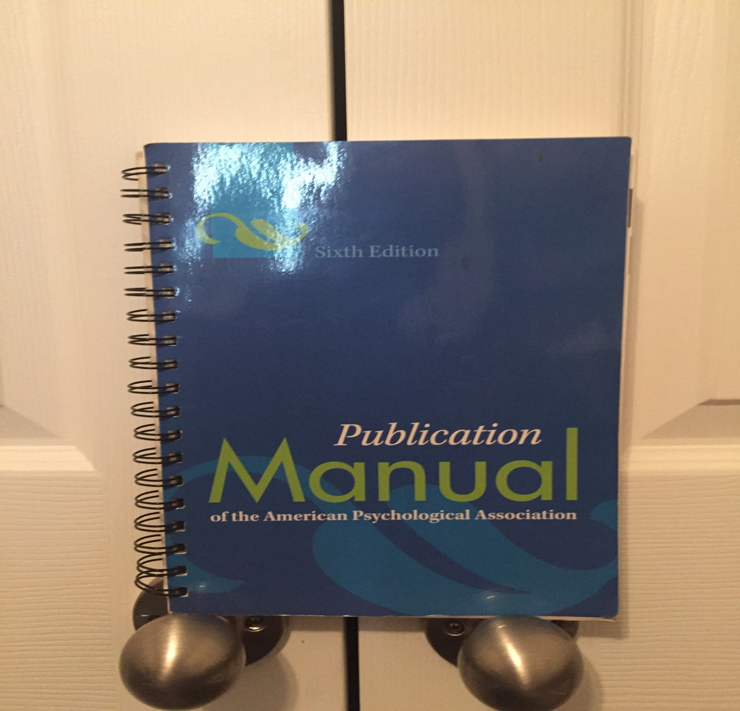

Slide 5
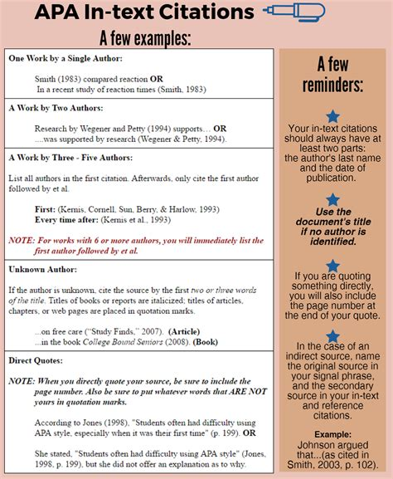

Slide 6
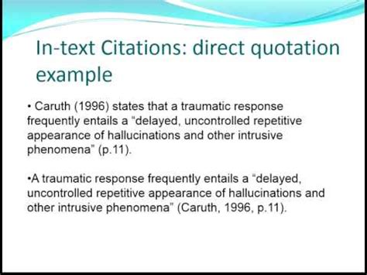
APA in-text citation for a direct quote

Slide 7
NOT an APA Reference List
https://bizfluent.com/list-6715678-advantages-disadvantages-pie-chart.html
https://datavizcatalogue.com/methods/pie_chart.html
http://seeincolors.com/6-key-benefits-of-graphic-recording/

Slide 8
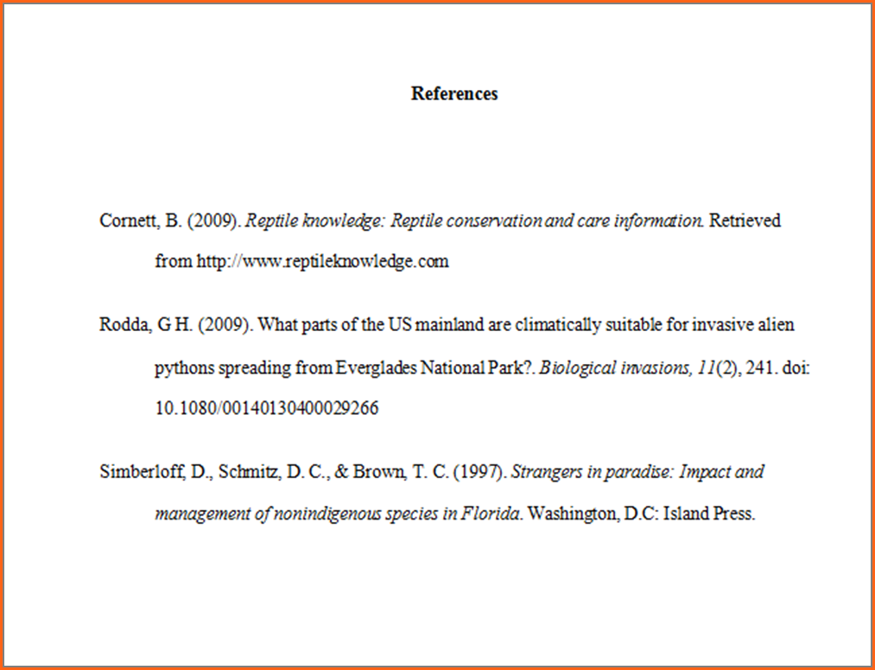
APA reference page

Slide 9
APA style formatting
Online sources:
http://www.apastyle.org/
http://apaformat.org/apa-in-text-citation/
https://owl.english.purdue.edu/owl/resource/560/01/

